Slide 1
Secure Software String Format Problems

Slide 2
Format String Problems
User Supplied
String
printf(userString);

Slide 3
Exploiting Format String Vulnerabilities - Discussion
What’s a format string?
How can they be used to manipulate memory?
To read memory?
To write memory?
The root of the problem is trusting user input (or not protecting format strings)
*

Slide 4
Format Strings
What is a format string?
float z = 1.243636;
printf (“name = %s; time = %02d:%02d; value=%10.4f“,
“toad”, 15, 0, z);
Output:
name = toad; time = 15:00; value= 1.2436
API Call (in this case, stdio.h)

Slide 5
Format Strings
What is a format string?
printf (str)
printf (“my string is %s” , str)
“The format string is composed of zero or more directives: ordinary characters (not%), which are copied unchanged, to the output stream; and conversion specifications, each of which results in fetching zero or more subsequent arguments. Each conversion is introduced by character % and ends with a conversion specifier. [ISO “C99”, 2005]

Slide 6
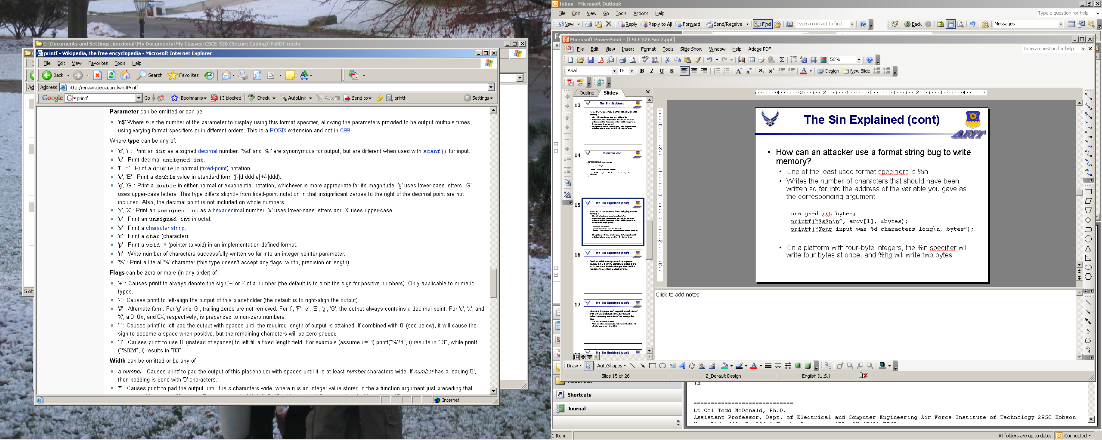
Format Strings
%[parameter][flags][width][.precision][length]type
http://en.wikipedia.org/wiki/Printf

Slide 7
How does printf work?
printf (“Number is: %d”, 5);
printf (“%s is: %d”, “Number”, 5);
C/C++ supports passing a variable number of arguments by specifying an ellipsis (…) as the last (or only) argument
Most common set of functions to take variable length arguments is the printf family: printf, sprintf, snprintf, fprintf, vprintf, and so on
The first few variables might be passed via registers, but eventually the stack has to be used.

Slide 8
How does printf work?
#include <stdio.h>
int main(int argc, char* argv[])
{
printf(“%x %x”);
return 0;
}
What happens here?

Slide 9
How far can we read into the stack?
0012FE94
where we start printing….
41 41 41 41
AAAA
AAAA
%08x
%08x
%08x
41 41 41 41
Eventually, we could start printing out our own parameters to the printf() function call
25 30 38 78
25 30 38 78
. . .
25 30 38 78

Slide 10
Why %x?
%u, %d – work just as well as %x
%f – floating point has a potential divide by zero issue (%.f gets around this)
%s – treat what you’re reading as a char*
Combining %x and %s
Use %x to “pop the stack”
Then use %s to print the memory information of interest

Slide 11
Using %n
int main(int argc, char* argv[]) {
unsigned int bytes;
printf(“%s%n\n”, argv[1], &bytes);
printf(“Your input was %d characters long\n”, bytes);
return 0;
}
“Writes the number of characters that should have been written so far into the address of the variable you gave as the corresponding argument”

Slide 12
Using %n
int main(int argc, char* argv[]) {
unsigned int address;
printf(“%u15%u15...%n\n”, argv[1], &address);
printf(“Your input was %d characters long\n”, bytes);
return 0;
}
Figure out where in the stack they want the address.
Tweak the field width specifiers until the number of bytes written is what they’d like

Slide 13
Running Arbitrary Code
The width specifier allows us to pad output to almost any length, allowing us to overwrite a single byte with the value of our choice.
Multiple %n allows us to write multiple bytes.
Overwriting 4 (or 8) bytes allows the attacker to overwrite addresses.
Because we can generally guess the address of a function pointer or return address on the stack, we can cause a string we supply to be executed as code (assuming the address is on the stack).
The Shellcoder’s Handbook, Anley et al, Wiley, 2007.

Slide 14
Format Guard - Discussion
Overview
How does it work?
What systems is it implemented on?
What are other options that the authors considered?
What are its limitations?
Was there anything you found particularly interesting? Or helpful?
*
How long did you spend reading and assessing these articles?

Slide 15
Detecting Format String Vulnerabilities with Type Qualifiers - Discussion
How does it work?
How many of you read the whole paper (in detail)
What were some of the real-world issues the authors encountered?
Do the coders need to do anything?
How long to set up/ test/ investigate?
Was there anything you found particularly interesting? Or helpful?
*
How long did you spend reading and assessing these articles?

Slide 16
Format String Problems
User Supplied
String
printf(userString);

Slide 17
OnlineGDB Example

Slide 18
Related Vulnerabilities
If attackers can specify a format string for output to a log file or database, they can cause incorrect or misleading logs (can be a problem for HLLs as well)
fprintf(STDOUT, err_msg);
If the application reading the logs trusts them, may lead to execution of arbitrary code
Embedding control characters in log files cause problems
Backspaces can be used to erase things, line terminators can obfuscate or even eliminate the attacker’s traces
Common practice to put application strings in external files for internationalization
If your application fails to protect the file properly, then an attacker can supply format strings because of a lack of proper file access

Slide 19
Finding Format String Vulnerabilities
In C/C++, look for functions from the printf family
printf(user_input);
fprintf(STDOUT, user_input);
Never pass user input directly to a formatting function
Look for functions with variable number of arguments (…)
Dynamic Testing
e.g., user input that asks for a filename…
Pass “notarealfile%x%x” and see what you get back

Slide 20
Format String Problems
Variable arguments functions are embedded throughout real world programs
They have a necessary purpose
Need careful checking to make sure they aren’t abused
Takeaways:
Format string problems occur (mostly) from variable argument functions
printf family is the most common culprit,
log family is harder to track down because occur less frequently
Always be suspicious of user input; when possible, avoid it!

